Slide 1
WELCOME
JAVA SWING
‘SCHOOL MANAGEMENT SYSTEM’
1
DESIGNED BY SHARIFUL ISLAM
ID-1245709
GO TO
1
2
3
4
5
6
7
8
9
+
+
+

Slide 2

SUBMITTED TO
MD. MOSHAHIDUL ISLAM
PROJECT CONSULTANT, J2EE
IDB-BISEW
GO TO
1
2
3
4
5
6
7
8
9
+
+
+

Slide 3
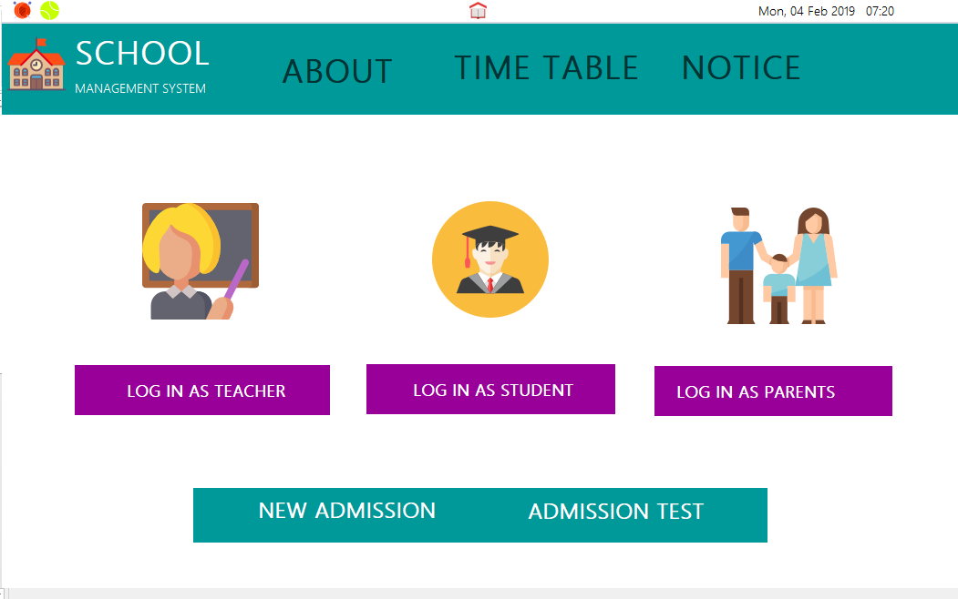
LETS TAKE A LOOK
SCHOOL
TEACHERS
NEW ADD
MANAGE
HOME
PAYMENT
RESULT SHEET
GO TO
1
2
3
4
5
6
7
8
9
+
+
+

Slide 4
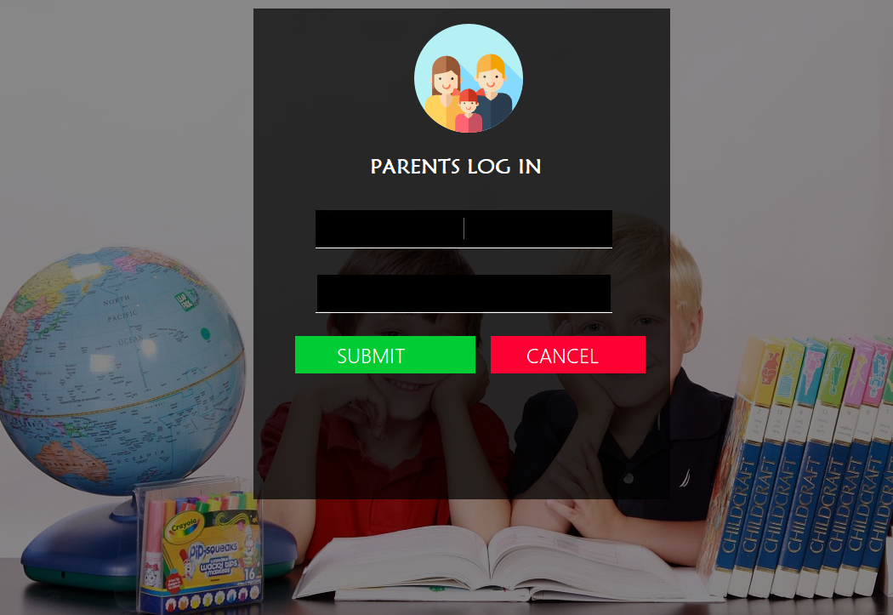
LETS TAKE A LOOK
SCHOOL
TEACHERS
NEW ADD
MANAGE
HOME
PAYMENT
RESULT SHEET
GO TO
1
2
3
4
5
6
7
8
9
+
+
+

Slide 5

LETS TAKE A LOOK
SCHOOL
TEACHERS
NEW ADD
MANAGE
HOME
PAYMENT
RESULT SHEET
GO TO
1
2
3
4
5
6
7
8
9
+
+
+

Slide 6
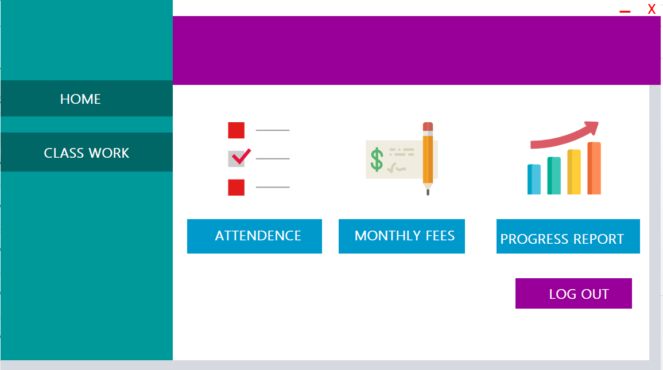
LETS TAKE A LOOK
SCHOOL
TEACHERS
NEW ADD
MANAGE
HOME
PAYMENT
RESULT SHEET
GO TO
1
2
3
4
5
6
7
8
9
+
+
+

Slide 7
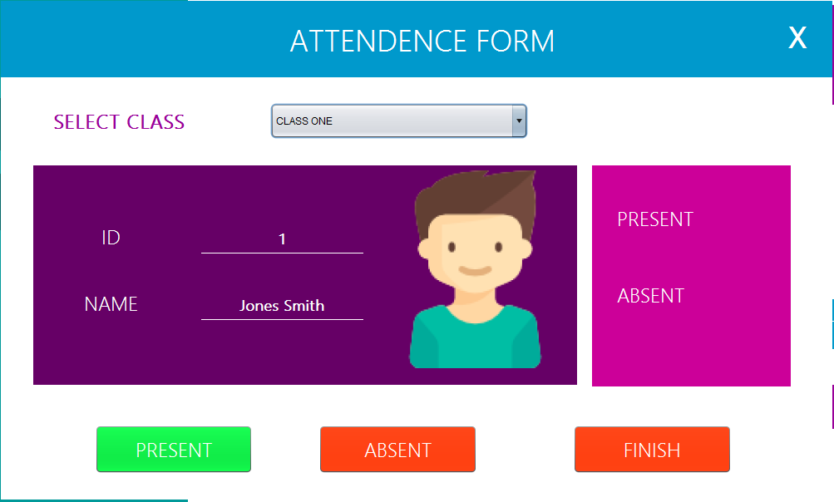
LETS TAKE A LOOK
SCHOOL
TEACHERS
NEW ADD
MANAGE
HOME
PAYMENT
RESULT SHEET
GO TO
1
2
3
4
5
6
7
8
9
+
+
+

Slide 8
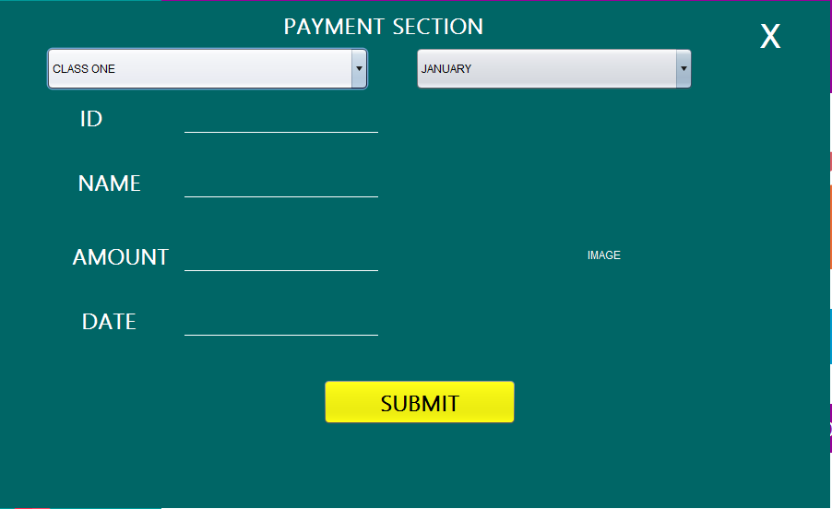
LETS TAKE A LOOK
SCHOOL
TEACHERS
NEW ADD
MANAGE
HOME
PAYMENT
RESULT SHEET
SCHOOL
FASHION
GALLERY
TECHNOLOGY
FOOD
GIFT
CONTACTS
SUPER SHOP
FASHION
GALLERY
TECHNOLOGY
FOOD
GIFT
CONTACTS
GO TO
1
2
3
4
5
6
7
8
9
+
+
+

Slide 9
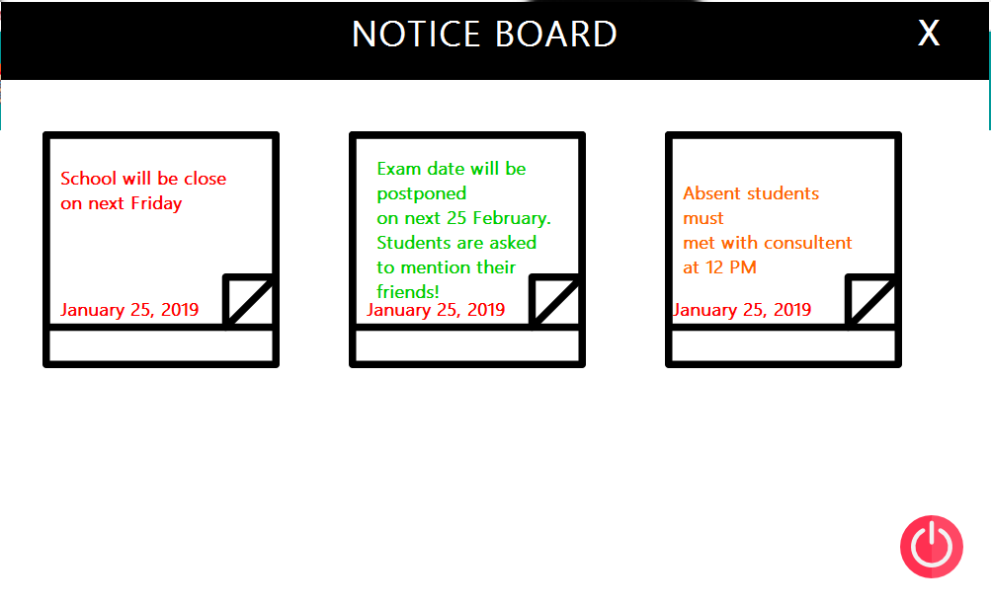
LETS TAKE A LOOK
SCHOOL
TEACHERS
NEW ADD
MANAGE
HOME
PAYMENT
RESULT SHEET
SCHOOL
FASHION
GALLERY
TECHNOLOGY
FOOD
GIFT
CONTACTS
SUPER SHOP
FASHION
GALLERY
TECHNOLOGY
FOOD
GIFT
CONTACTS
GO TO
1
2
3
4
5
6
7
8
9
+
+
+

Slide 10
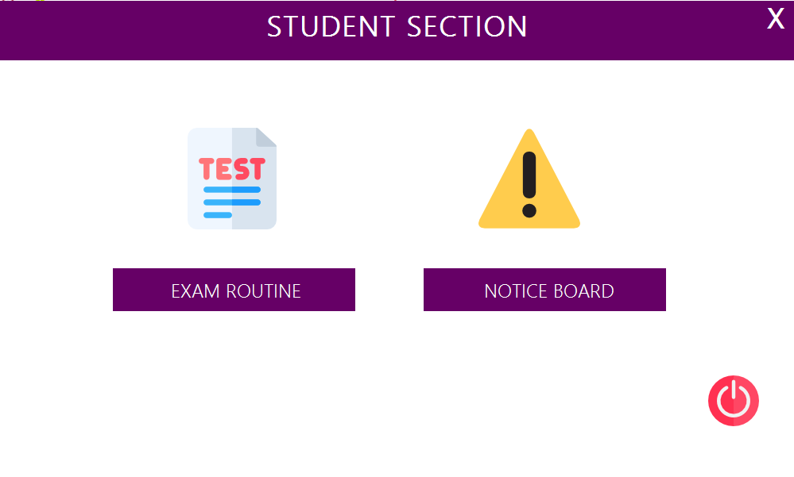
LETS TAKE A LOOK
SCHOOL
TEACHERS
NEW ADD
MANAGE
HOME
PAYMENT
RESULT SHEET
SCHOOL
FASHION
GALLERY
TECHNOLOGY
FOOD
GIFT
CONTACTS
SUPER SHOP
FASHION
GALLERY
TECHNOLOGY
FOOD
GIFT
CONTACTS
GO TO
1
2
3
4
5
6
7
8
9
+
+
+

Slide 11
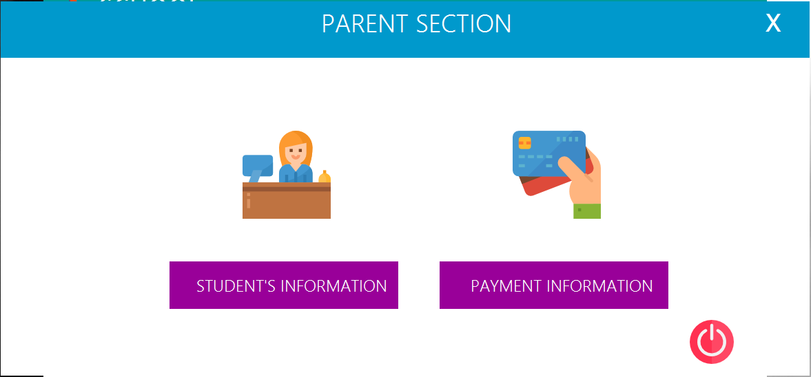
LETS TAKE A LOOK
SCHOOL
TEACHERS
NEW ADD
MANAGE
HOME
PAYMENT
RESULT SHEET
SCHOOL
FASHION
GALLERY
TECHNOLOGY
FOOD
GIFT
CONTACTS
SUPER SHOP
FASHION
GALLERY
TECHNOLOGY
FOOD
GIFT
CONTACTS
GO TO
1
2
3
4
5
6
7
8
9
+
+
+

Slide 12
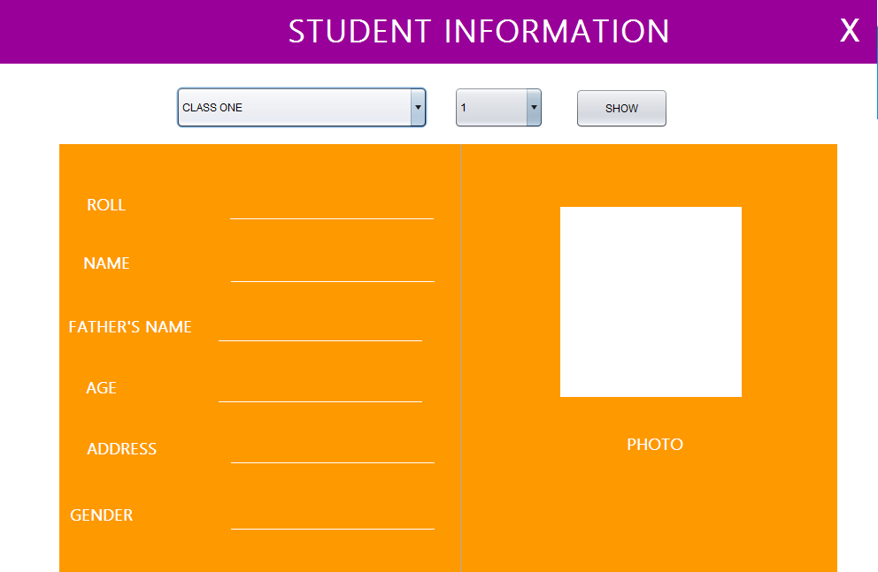
LETS TAKE A LOOK
SCHOOL
TEACHERS
NEW ADD
MANAGE
HOME
PAYMENT
RESULT SHEET
SCHOOL
FASHION
GALLERY
TECHNOLOGY
FOOD
GIFT
CONTACTS
SUPER SHOP
FASHION
GALLERY
TECHNOLOGY
FOOD
GIFT
CONTACTS
GO TO
1
2
3
4
5
6
7
8
9
+
+
+

Slide 13
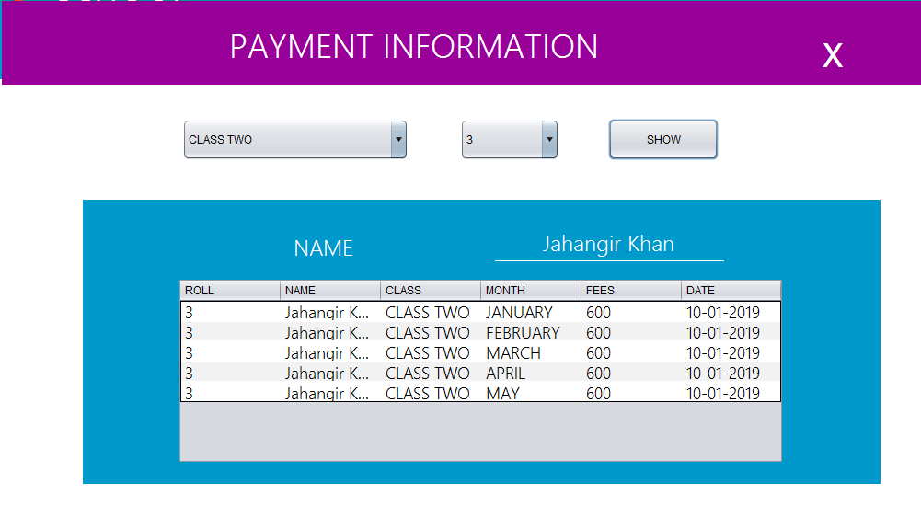
LETS TAKE A LOOK
SCHOOL
TEACHERS
NEW ADD
MANAGE
HOME
PAYMENT
RESULT SHEET
SCHOOL
FASHION
GALLERY
TECHNOLOGY
FOOD
GIFT
CONTACTS
SUPER SHOP
FASHION
GALLERY
TECHNOLOGY
FOOD
GIFT
CONTACTS
GO TO
1
2
3
4
5
6
7
8
9
+
+
+

Slide 14
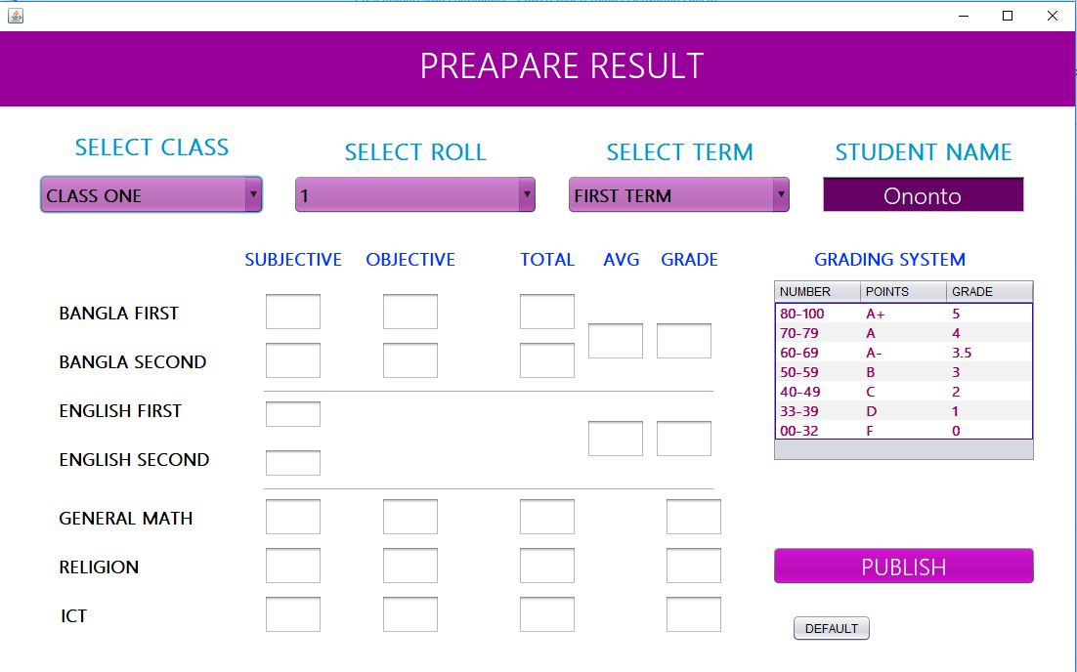
LETS TAKE A LOOK
SCHOOL
TEACHERS
NEW ADD
MANAGE
HOME
PAYMENT
RESULT SHEET
GO TO
1
2
3
4
5
6
7
8
9
+
+
+

Slide 15
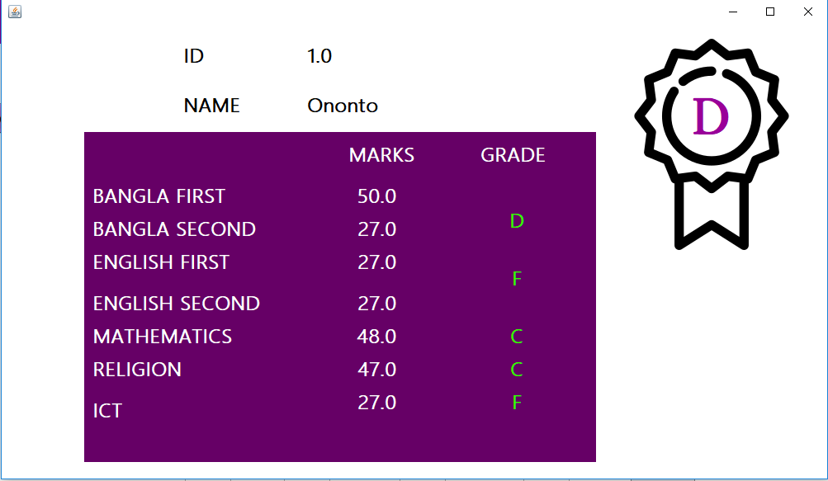
LETS TAKE A LOOK
SCHOOL
TEACHERS
NEW ADD
MANAGE
HOME
PAYMENT
RESULT SHEET
GO TO
1
2
3
4
5
6
7
8
9
+
+
+

Slide 16
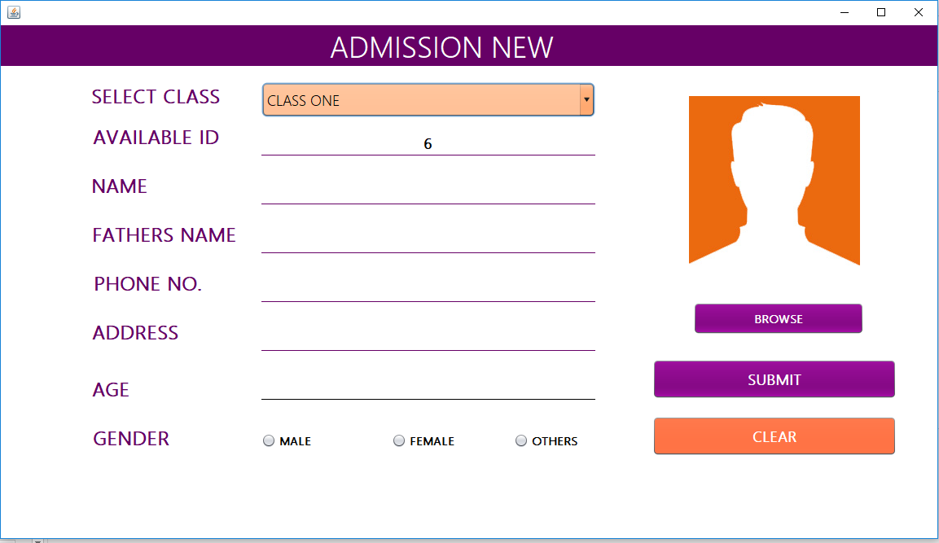
LETS TAKE A LOOK
SCHOOL
TEACHERS
NEW ADD
MANAGE
HOME
PAYMENT
RESULT SHEET
GO TO
1
2
3
4
5
6
7
8
9
+
+
+

Slide 17
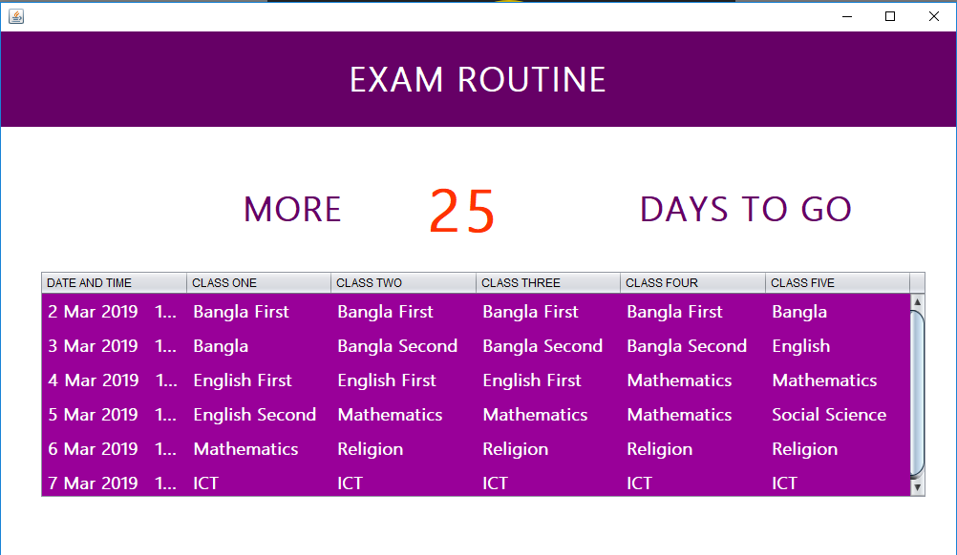
LETS TAKE A LOOK
SCHOOL
TEACHERS
NEW ADD
MANAGE
HOME
PAYMENT
RESULT SHEET
GO TO
1
2
3
4
5
6
7
8
9
+
+
+

Slide 18



MOST PROFITABLE SECTION
50
02
03
STUDENTS
TEACHERS
PARENTS
BEST SELLING SECTION
CLEAN KITCHEN COOK
TRENDY DESIGN
GO TO
1
2
3
4
5
6
7
8
9
+
+
+

Slide 19
THANK YOU
VISIT US ANYTIME
GO TO
1
2
3
4
5
6
7
8
9
+
+
+

